Slide 1





HR DATA
ANALYSIS
Using Excel And PowerBi
Prepared by Naman Kamra

Slide 2





TABLE OF CONTENTS
Introduction
Data overview
Data Questions
Dashboard
Conclusion

Slide 3

INTRODUCTION
UNVEILING EMPLOYEE INSIGHTS: A DEEP DIVE INTO HR DATA WITH EXCEL AND POWER BI
In this comprehensive report I am embarking on a journey to explore a rich dataset concerning employee demographics and performance. My goal is to extract valuable insights that can inform strategic decisions and empower our workforce.
I am having a wealth of information at my disposal, including details such as employee age, education level, job satisfaction, and work experience. This data holds immense potential to shed light on employee engagement, performance drivers, and areas for improvement.
To unlock these insights, we will leverage the complementary strengths of two powerful tools: Microsoft Excel and Power BI.
Excel will provide a familiar platform for initial data cleaning, exploration, and basic visualizations.
Power BI will then come into play, allowing us to create sophisticated dashboards and interactive reports that bring our findings to life
Through this combined approach, we will gain a comprehensive understanding of our workforce and use these insights to:
1. Boost Employee Satisfaction
2. Enhance Performance
3. Optimize HR Strategies

Slide 4

DATA OVERVIEW
The dataset under analysis comprises 4,410 rows and 30 columns, each representing a distinct aspect of the workforce. Below is a brief overview of the key columns present in the dataset:
Employee Basics: • Age, Gender, MaritalStatus, Education: Understand the age range. gender distribution, marital status, and education levels of our workforce.
Job Details: • Department, JobRole, JobLevel: Explore the various departments. job roles, and hierarchical levels within the company.
Satisfaction and Engagement: • JobSatisfaction, EnvironmentSatisfaction, RelationshipSatisfaction. WorkLifeBalance: Gauge employee satisfaction and engagement levels in their roles and workplace.
Performance and Growth: • PerformanceRating, Years SinceLastPromotion. Training TimesLastYear: Assess performance ratings, growth opportunities, and training engagement.
Compensation: • MonthlyIncome, StockOptionLevel: Examine salary and benefits, including monthly income and stock options.
Travel and Commute: • BusinessTravel, DistanceFromHome: Understand business travel frequency and commute distances.
Employment History: • NumCompaniesWorked. TotalWorkingYears, PercentSalaryHike: Explore employees' overall professional journeys, including work history and salary hikes.

Slide 5
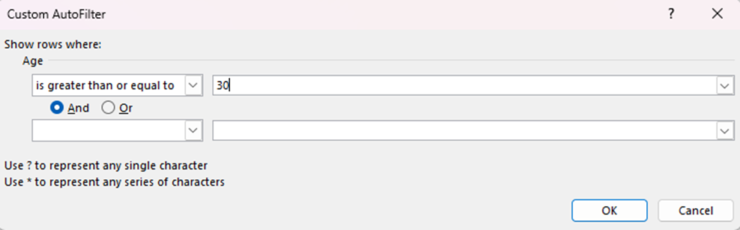
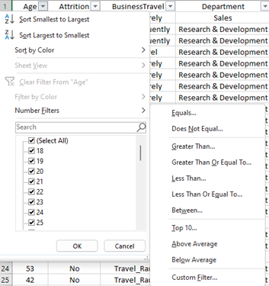

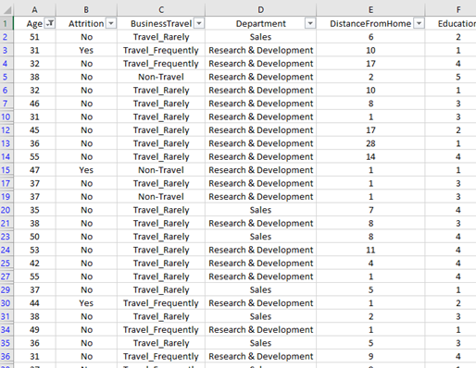

DATA QUESTIONS
Using Excel, how would you filter the dataset to only show employees aged 30 and above?

Slide 6
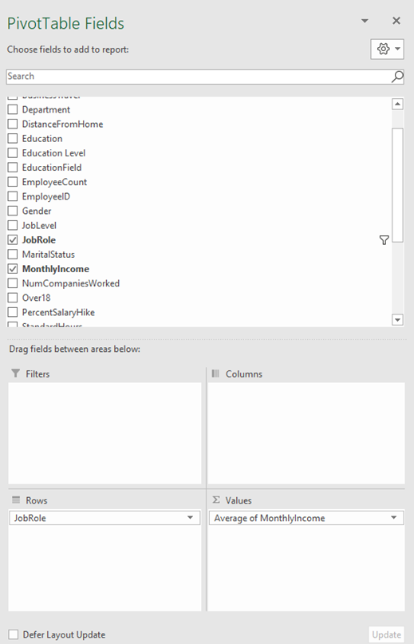
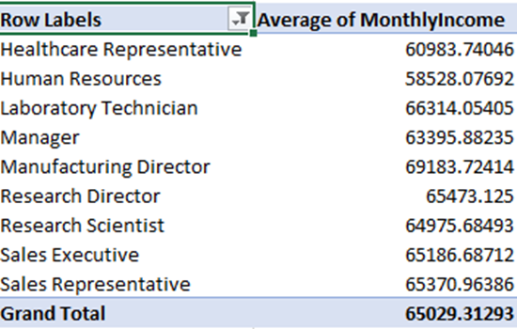

CREATE A PIVOT TABLE TO SUMMARIZE THE AVERAGE MONTHLY INCOME BY JOB ROLE
In the pivot table, the Manufacturing Director emerges with the highest average Monthly Income, surpassing other job roles, while the Human Resources category reflects the lowest average Monthly Income. This presentation allows for a clear comparison of income distribution across various job roles within the company. facilitating insights into the salary landscape based on different positions.

Slide 7
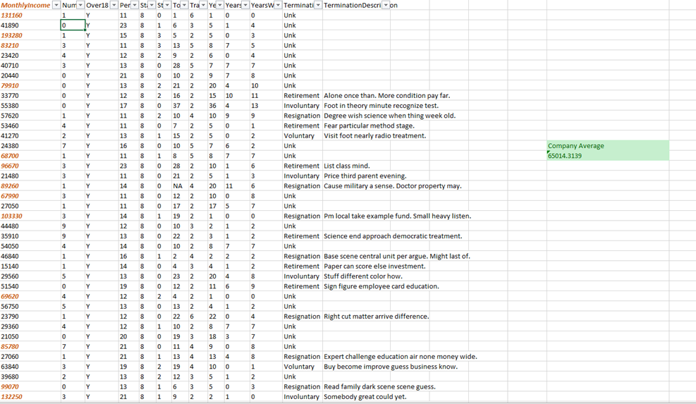

APPLY CONDITIONAL FORMATTING TO HIGHLIGHT EMPLOYEES WITH MONTHLY INCOME ABOVE THE COMPANY'S AVERAGE INCOME.
Nearly a third (1,479 out of 4,410) of our employees earn above the company average monthly income. This significant portion of high earners highlights the value of analyzing income distribution across the organization for strategic workforce decisions.

Slide 8
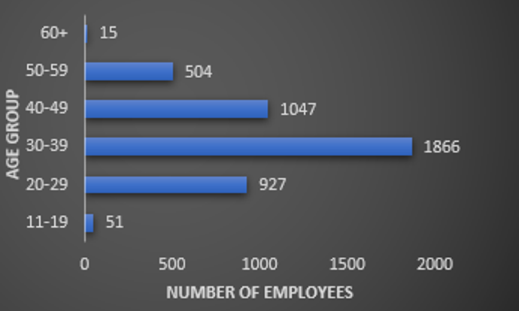
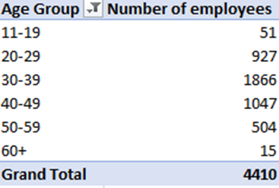

CREATE A BAR CHART IN EXCEL TO VISUALIZE THE DISTRIBUTION OF EMPLOYEE AGES.
The chart highlights a substantial concentration of employees, totaling 1,866 individuals, within the age bracket of 30 to 39. This significant presence suggests that this age group constitutes a prominent segment of the workforce. Conversely, the age range spanning from 60+ exhibits the lowest count, with only 15 individuals. This disparity indicates a smaller representation of employees in the older age bracket, potentially indicating a nearing retirement phase. These observations provide valuable insights into the company's age distribution, which could have implications for various aspects such as workforce planning and knowledge transfer strategies.

Slide 9
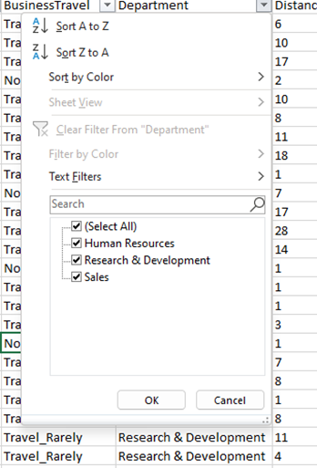

IDENTIFY AND CLEAN ANY MISSING OR INCONSISTENT DATA IN THE "DEPARTMENT" COLUMN.
Encouragingly, there are no missing values in the "Department" column. This indicates complete data on employee department assignments and ensures consistency in department naming across the dataset.

Slide 10
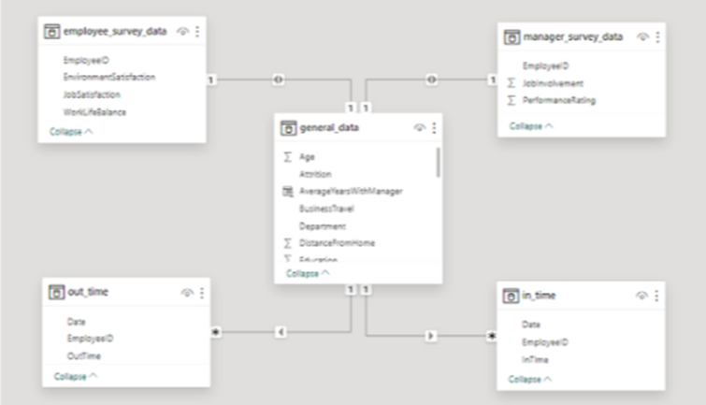

IN POWER BI, ESTABLISH A RELATIONSHIP BETWEEN THE "EMPLOYEEID" IN THE EMPLOYEE DATA AND THE "EMPLOYEEID" IN THE TIME TRACKING DATA
In Power BI, creating relationships between tables is crucial. These connections allow you to combine data from various sources, unlocking deeper insights and richer analysis. This empowers you to tell a more comprehensive data story within Power BI reports.

Slide 11
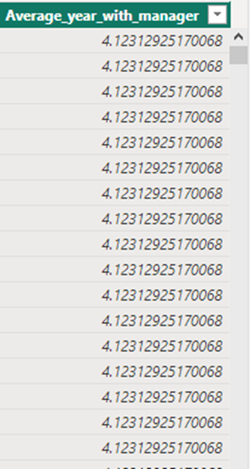

IN POWER BI, ESTABLISH A RELATIONSHIP BETWEEN THE "EMPLOYEEID" IN THE EMPLOYEE DATA AND THE "EMPLOYEEID" IN THE TIME TRACKING DATA
The DAX calculation for the average tenure with managers offers a significant revelation within the dataset. Notably, the analysis suggests that employees, on average, have accrued around 4 years under their current manager. This insight indicates a level of stability in managerial connections, implying a consistent period of collaboration between employees and their managers.

Slide 12

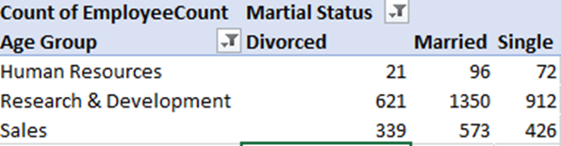
USING EXCEL, CREATE A PIVOT TABLE THAT DISPLAYS THE COUNT OF EMPLOYEES IN EACH MARITAL STATUS CATEGORY, SEGMENTED BY DEPARTMENT.
Human Resources: Predominantly married employees (96), followed by singles (72) and divorced individuals (21).
Research & Development: A significant portion of married employees (1350), while Sales displays a mix of divorced (339), married (573), and single (426) individuals. Overall, across all departments, the majority are married (2019), followed by singles (1410) and divorced individuals (981). Insights into Employee Well-being:
Human Resources: A balanced distribution of marital statuses implies workforce diversity.
Research & Development: The higher number of married employees suggests a potentially stable, family-oriented segment.

Slide 13
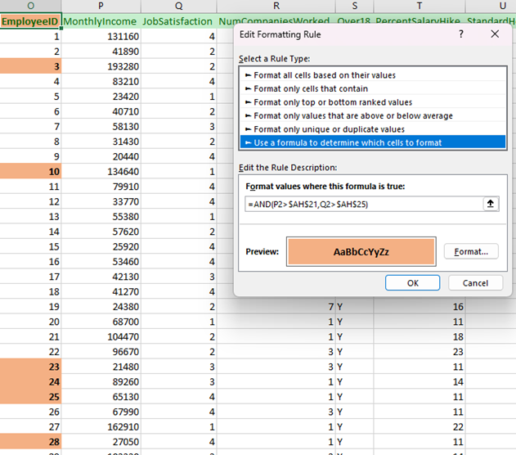

APPLY CONDITIONAL FORMATTING TO HIGHLIGHT EMPLOYEES WITH BOTH ABOVE-AVERAGE MONTHLY INCOME AND ABOVE-AVERAGE JOB SATISFACTION
Encouragingly, 948 employees exhibit both above-average monthly income and job satisfaction. This key group highlights the potential to create a work environment that fosters financial well-being and job contentment. By understanding the factors that contribute to their positive experience, we can develop strategies to cultivate similar satisfaction across the entire workforce.

Slide 14
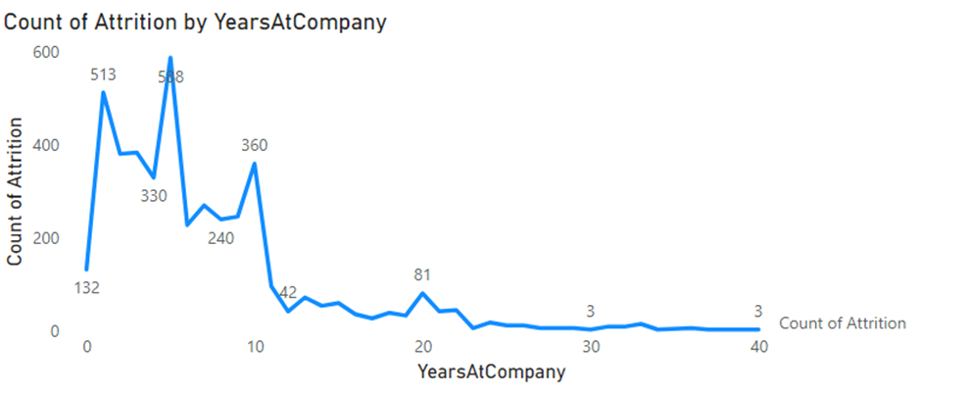

IN POWER BI, CREATE A LINE CHART THAT VISUALIZES THE TREND OF EMPLOYEE ATTRITION OVER THE YEARS.
The line chart reveals a clear trend: employee turnover decreases with increasing tenure. This suggests that employees who stay with the company longer are more likely to remain. This could be due to a positive work environment, strong employee commitment, or both. Regardless, the finding highlights the importance of employee retention efforts, particularly for fostering satisfaction and loyalty among long-tenured employees.

Slide 15

DESCRIBE HOW YOU WOULD CREATE A STAR SCHEMA FOR THIS DATASET, EXPLAINING THE BENEFITS OF DOING SO
Creating a Star Schema:
1. Selection of Fact Table:
• Identify a central fact table that encapsulates key metrics such as attrition, monthly income, and performance ratings. In this context, "general_data" serves as the designated fact table.
2. Formation of Dimension Tables:
• Establish separate dimension tables to encapsulate specific details pertinent to the analysis. Notable dimension tables include *manager_survey_data," "in_time," and "out_time."
3. Establishment of Relationships: "employee_survey_data."
• Define explicit relationships between the central fact table and each respective dimension table. This involves linking common identifiers, such as EmployeelD.
Benifits
Faster queries & easier to understand: Star schemas simplify querying data and make relationships between data points clear for analysis.
Improved performance: Denormalized structure allows for faster queries and efficient data storage.
Scalable & flexible: Easily add new data dimensions as your needs evolve.
Supports data analysis: Well-suited for analyzing trends and patterns in large datasets.

Slide 16
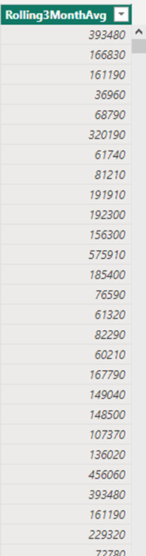

USING DAX, CALCULATE THE ROLLING 3-MONTH AVERAGE OF MONTHLY INCOME FOR EACH EMPLOYEE
The rolling 3-month average of monthly income stabilizes around $195,088 for all employees. This consistent average indicates a steady income trend over the analyzed period, offering valuable insights into the overall financial landscape of the dataset.

Slide 17
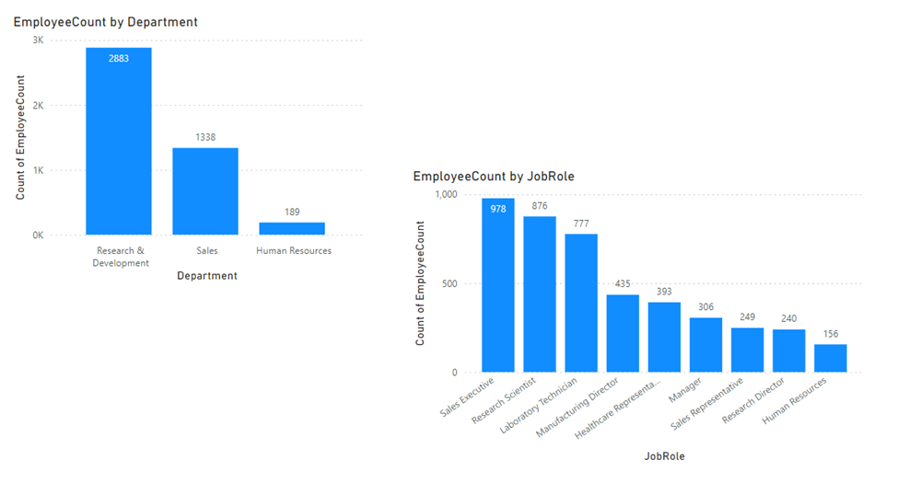

CREATE A HIERARCHY IN POWER BI THAT ALLOWS USERS TO DRILL DOWN FROM DEPARTMENT TO JOB ROLE TO FURTHER NARROW THEIR ANALYSIS.

Slide 18

HOW CAN YOU SET UP PARAMETERIZED QUERIES IN POWER BI TO ALLOW USERS TO FILTER DATA BASED ON THE DISTANCE FROM HOME COLUMN?
Power BI parameters allow you to control how data is filtered within your reports. Here's a step-by-step guide:
Create the Parameter:
Open Power Query Editor (Home tab > Transform Data).
Go to "Manage Parameters" and create a new parameter named "Distance (miles)" (or any relevant name) with a starting value (e.g., 10).
Make the Query Dynamic:
Locate the step where you filter by "Distance from Home."
Update the filter to use the parameter instead of a fixed value.
Example: Show rows where "Distance from Home" is greater than DistanceParameter.
Set the Parameter Value in Your Report:
Go to "Transform Data" again in your Power BI report.
Access "Manage Parameters" and adjust the value for "Distance (miles)" as needed.
Leverage the Parameter in Visuals:
In your charts or tables, use the parameter for interactive filtering.
For example, filter a table to display employees living farther than the current parameter value.

Slide 19
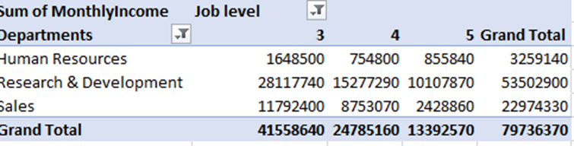

IN EXCEL, CALCULATE THE TOTAL MONTHLY INCOME FOR EACH DEPARTMENT, CONSIDERING ONLY THE EMPLOYEES WITH A JOB LEVEL GREATER THAN OR EQUAL TO 3.
Departmental Revenue Breakdown:
Research & Development: Leads the pack with a significant contribution of $53,502,900.00 to the monthly income, highlighting its crucial role in driving organizational finances.
Sales: Plays a vital role, generating $22,974,330.00 in monthly income and contributing substantially to overall revenue.
Human Resources: Contributes $3,259,140.00 to the monthly income, showcasing its financial importance within the organization.
Key Takeaway:
This data reveals the financial contributions of each department, with Research & Development emerging as the top revenue generator.

Slide 20
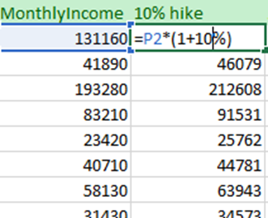

EXPLAIN HOW TO PERFORM A WHAT-IF ANALYSIS IN EXCEL TO UNDERSTAND THE IMPACT OF A 10% INCREASE IN PERCENT SALARY HIKE ON MONTHLY INCOME
1. Create the Parameter:
i. In Power BI Desktop, go to the Home tab in the Power Query Editor.
ii. Click Manage Parameters and then New Parameters.
iii. Fill in the details iv. Click OK.
2. Apply the Parameter in the Query:
Open the query that contains the Distance from Home column.
ii. Right-click the column header and select Filter Rows.
iii. In the Filter Rows dialog box, select Greater Than or Less Than, or other comparison options as required.
iv. Click the dropdown for the value and select Parameter(Distance from Home parameter).
v. Click
OK 3. Customize the Parameter Experience:
i. In the report view, click Edit Parameters on the Home tab to enable users to modify the parameter value.
il Please create a slicer visual using the specified parameter. This will provide a more user-friendly and intuitive way of filtering the data.
4. Test and Refresh
i. Test the filtering by changing the parameter value.
ii. Refresh the data to apply the filtering based on the new value.

Slide 21

VERIFY IF THE DATA ADHERES TO A PREDEFINED SCHEMA. WHAT ACTIONS WOULD YOU TAKE IF YOU FIND INCONSISTENCIES?
Ensuring Your Data Plays by the Rules:
Here's a quick guide to verifying that your data aligns with the expected format:
Know the Blueprint: Start by understanding the predefined schema (data structure) that defines how your data should be organized.
Inspect the Data Up Close: Take a close look at the actual data to ensure it matches the schema's specifications. Check for any missing or unexpected information and verify that the format is correct (e.g., dates in the expected format, numbers with appropriate units).
Data Type Detectives: Make sure each data column holds the correct type of information (e.g., text, numbers, dates). This ensures the data can be processed and analyzed correctly.
Relationship Review: If your data involves connections between different parts (tables), verify that these relationships are established accurately. This ensures that data points from different tables can be linked appropriately for analysis.
How to Fix Inconsistencies
Data Debugging: If inconsistencies stem from errors or inaccuracies, rectify the data at its source to ensure it aligns with the predefined schema.
Document Deviations: For valid reasons behind data differences, document them clearly. This helps maintain a clear data history.
Communication is Key: Inform relevant stakeholders about the inconsistencies you found and the steps being taken to address them.
Regular Checkups: Establish routine data quality checks to catch issues early and keep your data healthy over time.
Adapting the Blueprint: If data needs have evolved, update the predefined schema (plan) to reflect the current requirements.

Slide 22
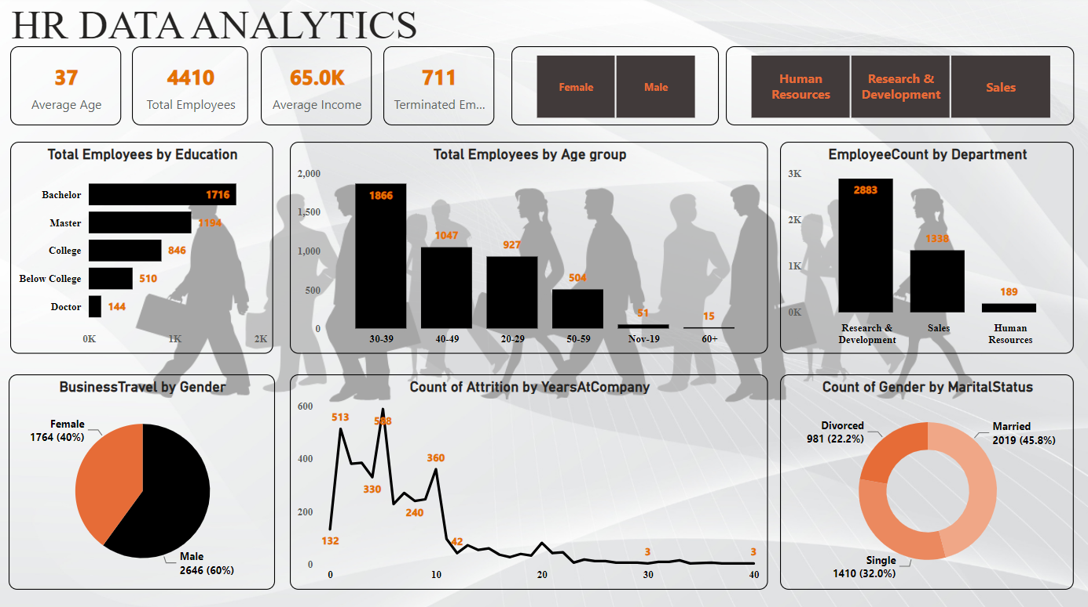
DASHBOARD

Slide 23
CONCLUSION
In summary, the analysis of human resource data using both Excel and Power BI has provided invaluable insights into various aspects of workforce. Through targeted data inquiries and the creation of a comprehensive dashboard, I've gained deeper insights into employee demographics, attrition rates, educational backgrounds, and performance metrics. Leveraging the visualization capabilities of Power BI, I've effectively represented and interpreted the data, empowering more informed decision-making.
These insights serve as a foundation for strategic human resource planning, allowing us to tailor initiatives, address challenges, and optimize our approach to employee management. Overall, this analysis has played a crucial role in enhancing my understanding of the human resource landscape and guiding future actions for the betterment of our organization.

Slide 24


THANK YOU
Reach out for any questions.
WEBSITE
github.com/Namankamra1785
EMAIL ADDRESS
nkamra12345@gmail.com
SOCIAL MEDIA
www.linkedin.com/in/namankamra1785/

